Slide 1


Crime Prediction for Houston
Yanhua Hou
Mentor: Alex Rutherford

Slide 2
Outlines
Problems and Clients
Data Acquisition and Data Cleaning
Exploratory Data Analysis
Machine Learning Models and Predictions
Conclusions and Future Work

Slide 3

Problems
?
How safe is the city we live in regarding crime rates?
What are the main types of crimes in neighborhoods?
How has the crime rate changed over past years?
Which types of crimes have increased and which has decreased and why?

Slide 4
Problems
Most importantly what message can we take from historical data to reduce crimes?
In case of crimes how can we be more prepared to minimize losses?
?

Slide 5
Clients
Police board, government, and general public would be beneficiaries.
Police officers can use this model to be better deployed.
The government can take precautions more efficiently.
Residents can use this model to better protect their lives and properties.

Slide 6
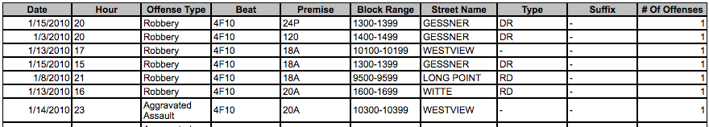

Data Acquisition
The crime data is acquired from HPD
It reports seven types of crimes on a monthly basis:
murder
rape
robbery
aggravated assault
burglary
theft
auto theft

Slide 7
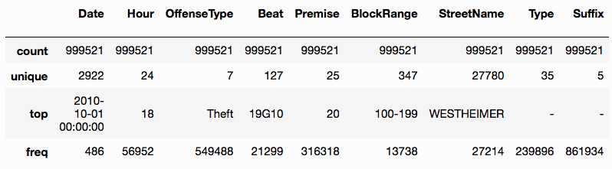
Data Cleaning
Drop empty columns, empty rows, and the rows with missing ‘Date’.
Fill columns with missing values by ‘UNK’.
Select Date’ in the range ‘2010-01-01’ to ‘2017-12-31’.
Clean column 'Hour' to contain 24 unique integers 0-23.
Clean column ‘OffenseType’ to contain 7 types of crimes.
Reduce the number of ‘Premise’ from 126 to 25.
Clean ‘Beat’, ‘Type’, ‘Suffix’, ‘StreetName’ by stripping whitespaces.
Check duplicates and drop duplicated observations.
A summary statistics of ‘object’ features

Slide 8
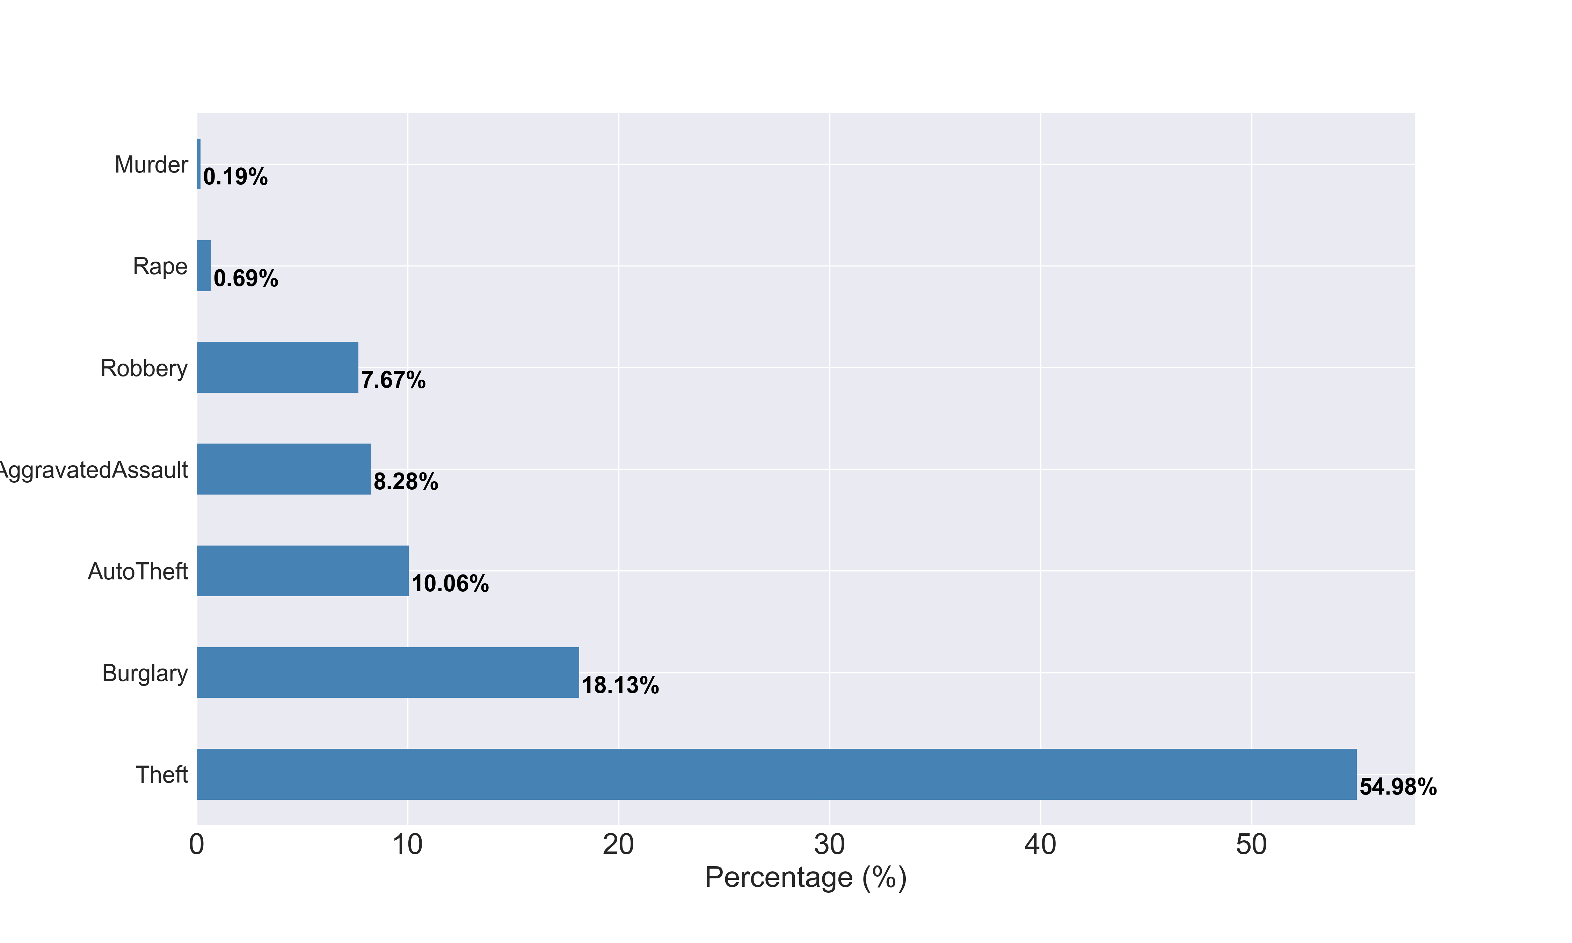
Exploratory Data Analysis
‘Theft’ is the dominant crimes, followed by ‘Burglary’, ‘AutoTheft’, ‘AggravatedAssault’ and ‘Robbery’ while ‘Rape’ and ‘Murder’ only takes a rather small portion.

Slide 9
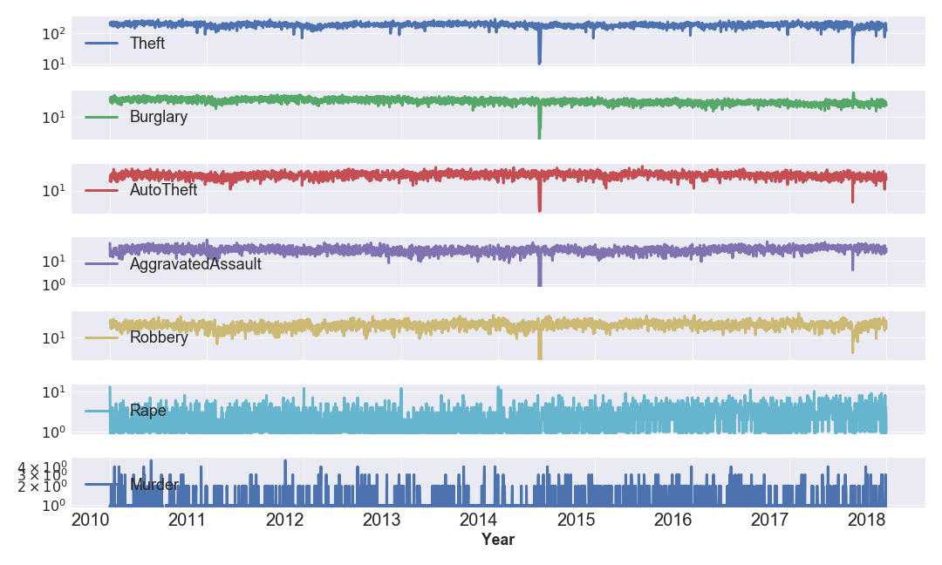
Exploratory Data Analysis
Time series analysis

Slide 10
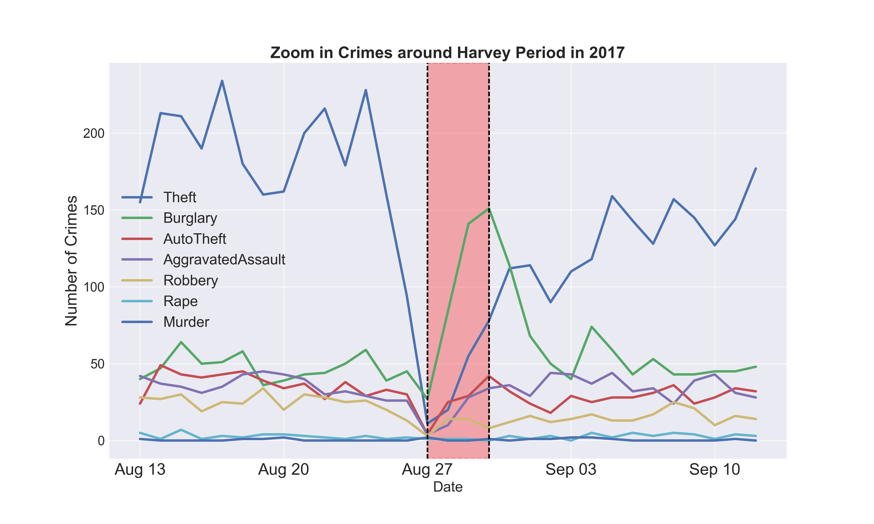
Exploratory Data Analysis
Time series analysis
In the hurricane Harvey Period, crimes dropped overall. However, ‘Burglary’ quickly increased followed by ‘Theft’, ‘AutoTheft’, ‘Robbery’ and ‘Assault’.

Slide 11
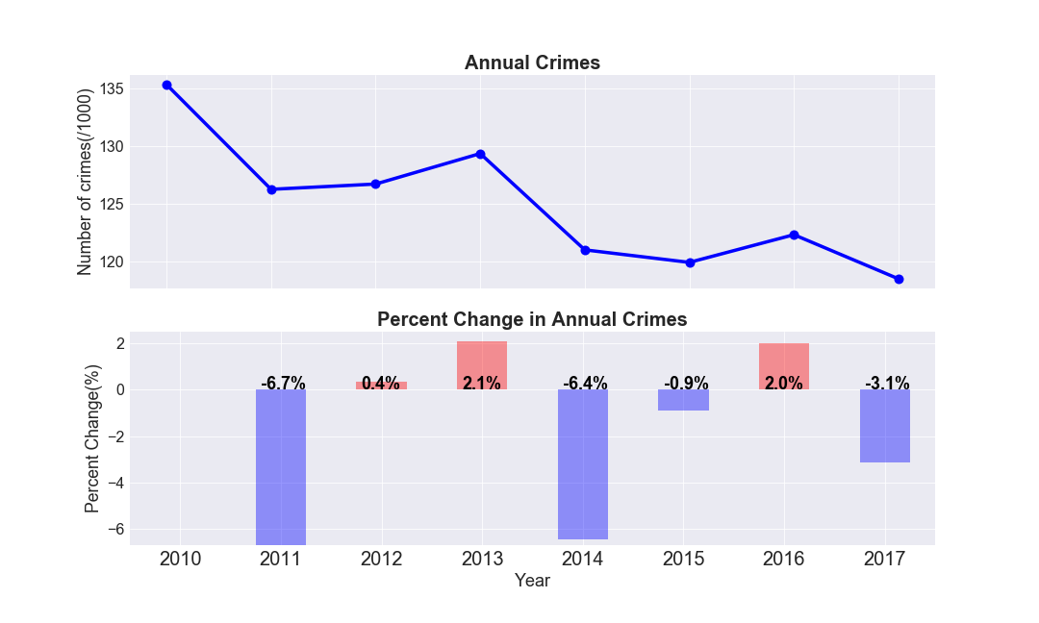
Exploratory Data Analysis
Time series analysis: year
The crime trend: overall crimes in Houston have a decreasing trend in 2017 compared to 2016.

Slide 12
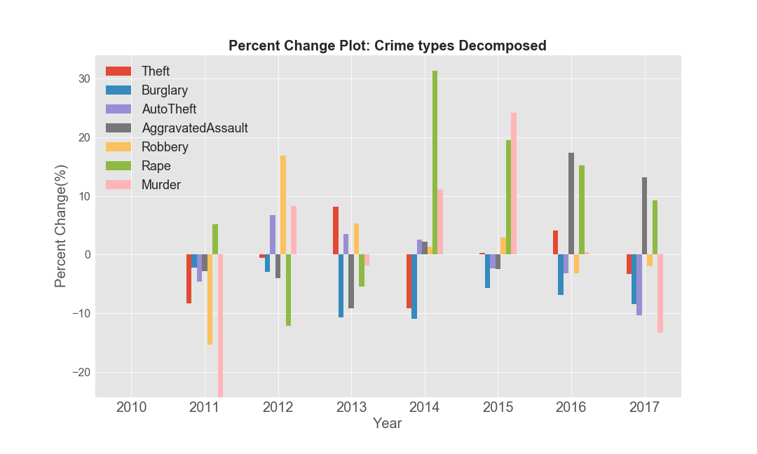
Exploratory Data Analysis
Time series analysis: year
The crime types decomposed: violent crimes like ‘AggravatedAssault’ and ‘Rape’ increased.

Slide 13
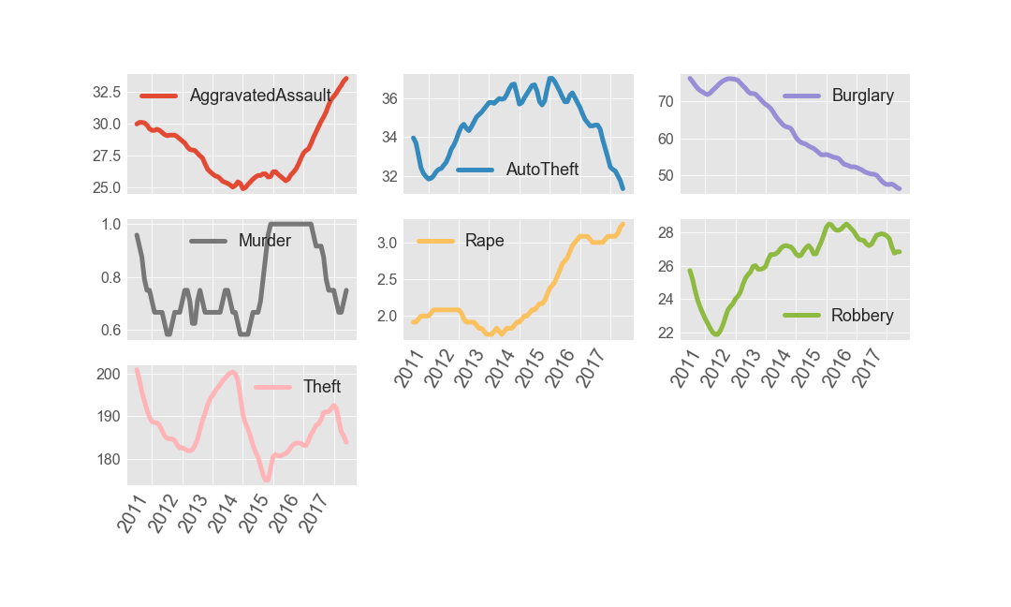
Exploratory Data Analysis
Time series analysis: trends
We apply the moving average model to smooth out short-term fluctuations and highlight long-term trends.

Slide 14
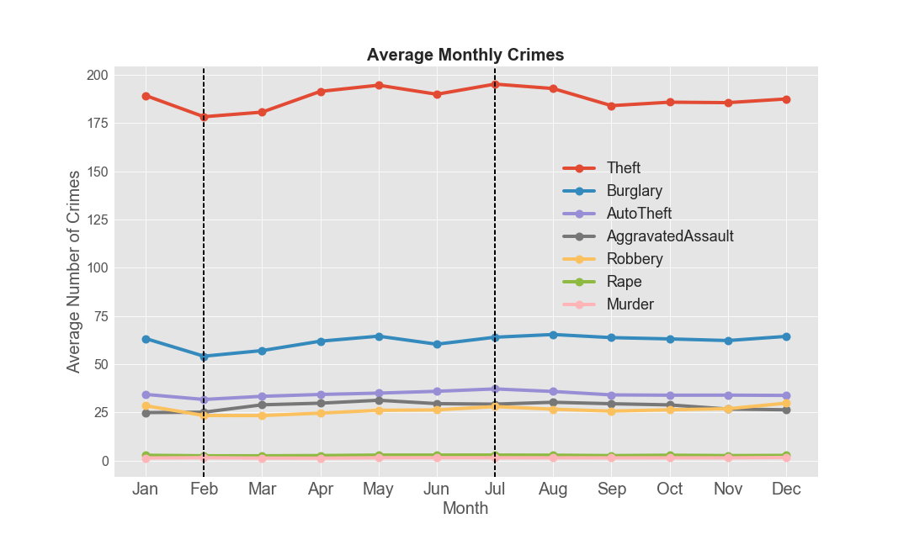
Exploratory Data Analysis
Time series analysis: month
Month tends: summer months have more occurrences than winter months

Slide 15
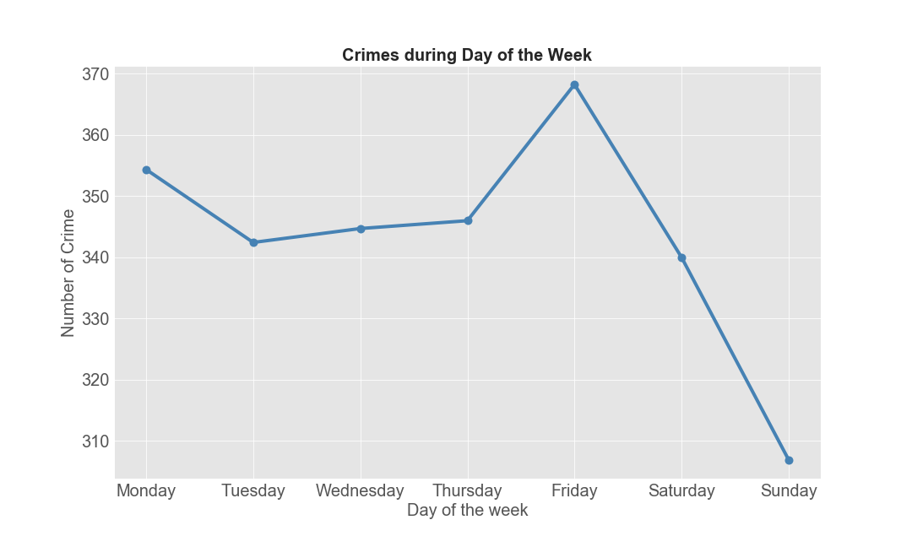
Exploratory Data Analysis
Time series analysis: week
Day tends: there are most crimes on Fridays and least crimes on Sundays on a weekly basis.

Slide 16
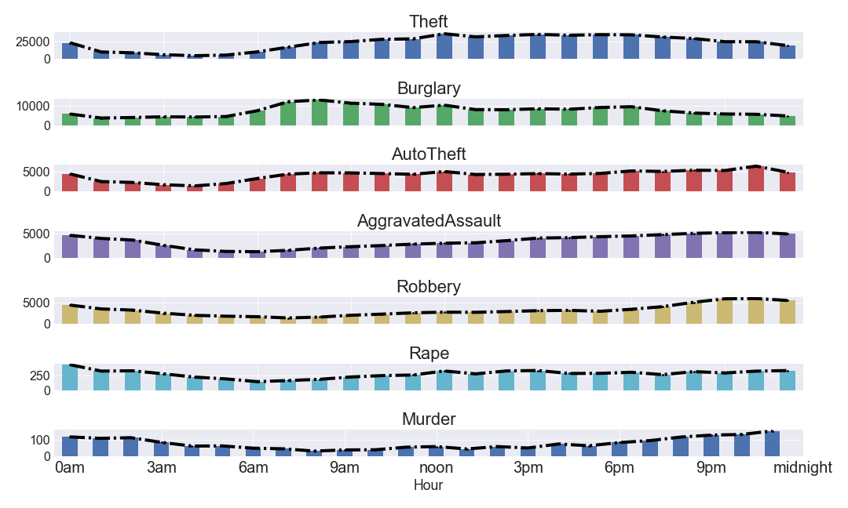
Exploratory Data Analysis
Time series analysis: day
‘Theft’ hits a peak in the middle of day; ‘Burglary’ peaks in the early morning; ‘Auto theft’, ‘Aggravated Assault’, ‘Robbery’ and ‘Murder’ peaks around late or middle night.

Slide 17
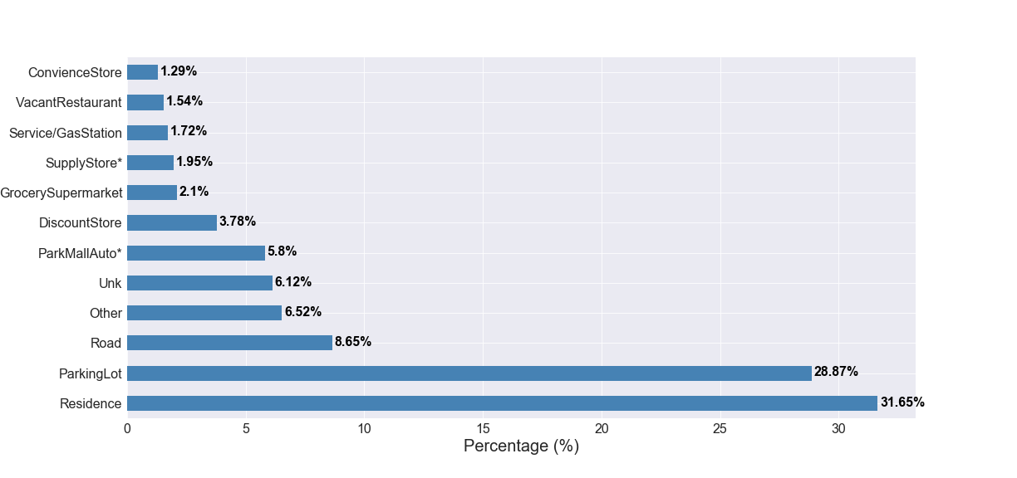
Exploratory Data Analysis
Geographical aspects analysis
The residential place and parking lot had the most frequent crimes.

Slide 18
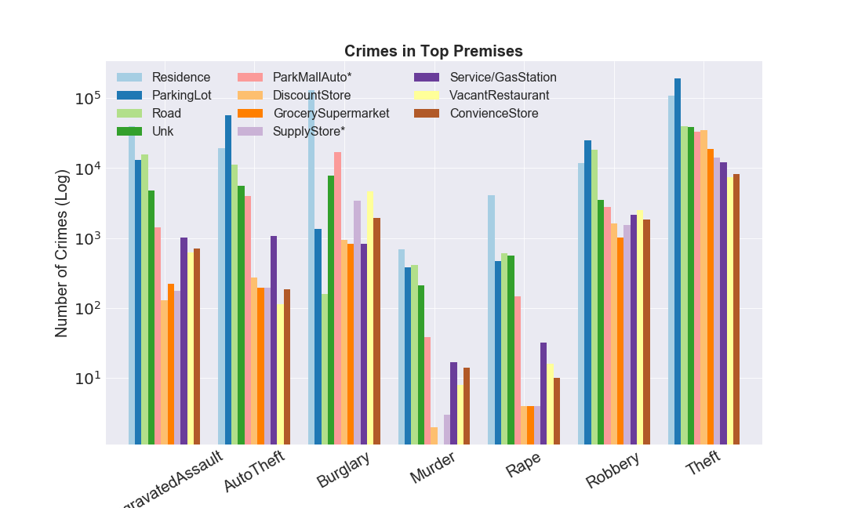
Exploratory Data Analysis
Geographical aspects analysis
In ‘residence’, dominant crimes include ‘Burglary’, ‘Theft’; Note that violent crimes like ‘Aggravated Assault’ and ‘Rape’ tend to occur most often in ‘residence’ than other premises.

Slide 19
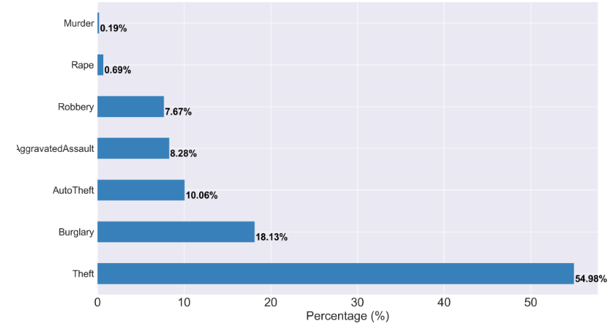
Machine Learning Models
Challenge
Imbalanced multi-classification problem with mostly categorical features.

Slide 20
Machine Learning Models
Feature Engineering
Concatenate ‘StreetName’ and ‘Type’ columns to ‘Address’.
Drop ‘StreetName’, ‘Type’ and ‘Suffix’.
Truncate ‘Beat’ to keep first 60%, rename others as ‘Other’.
Similar processing for ‘Premise’.
Add columns ‘Season’, ‘WeekDay’.
One-hot/label encode categorical variables.

Slide 21
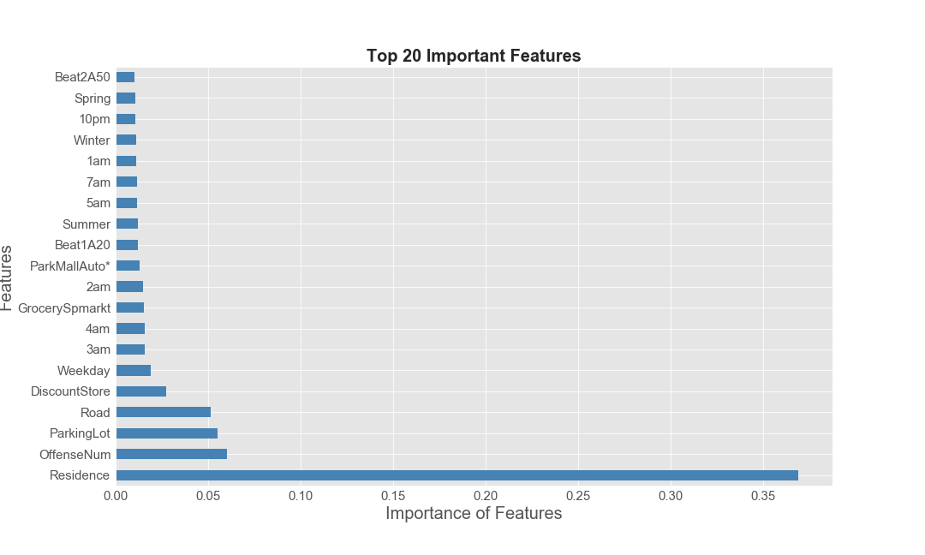
Machine Learning Models

Slide 22
Machine Learning Models
 | accuray | precision | recall | f1 | perct_change
Classifier
Dummy | 0.55 | 0.30 | 0.55 | 0.39 | 0.0
KNN | 0.58 | 0.51 | 0.58 | 0.52 | 5.5
DTree | 0.53 | 0.52 | 0.53 | 0.52 | -3.6
DT_rmAdres | 0.60 | 0.64 | 0.85 | 0.73 | 9.1
Dummy_theft | 0.55 | 0.30 | 0.55 | 0.39 | 0.0
DT_theft | 0.68 | 0.68 | 0.68 | 0.68 | 23.6
LogReg_theft | 0.68 | 0.68 | 0.68 | 0.68 | 23.6

Slide 23
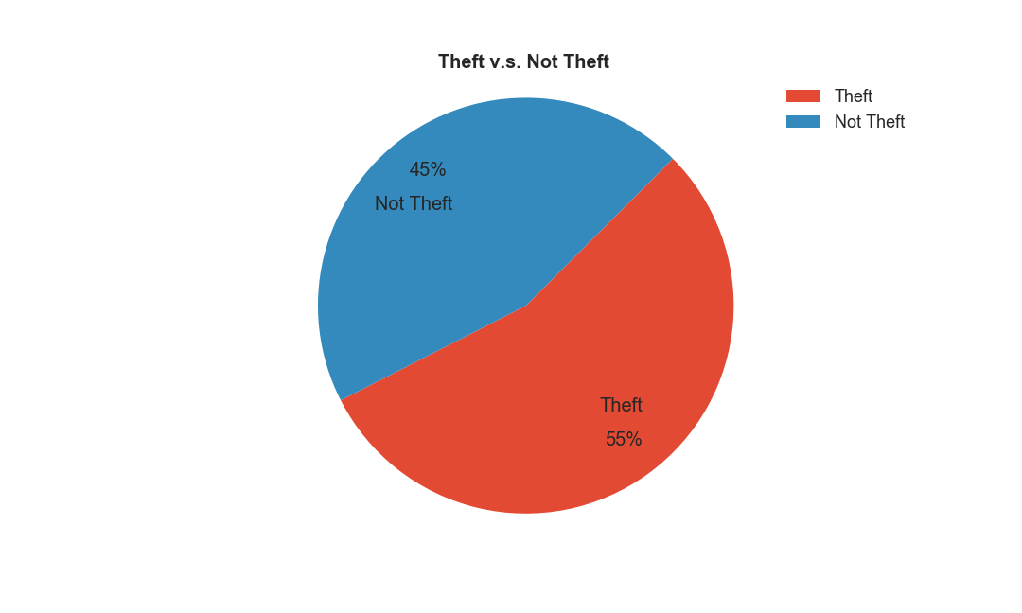
Machine Learning Models
55% is ‘Theft’ and 45% is ‘Not Theft’. We still use the ‘most_frequent’ strategy in dummy classifier. It gives an accuracy of 55%.

Slide 24
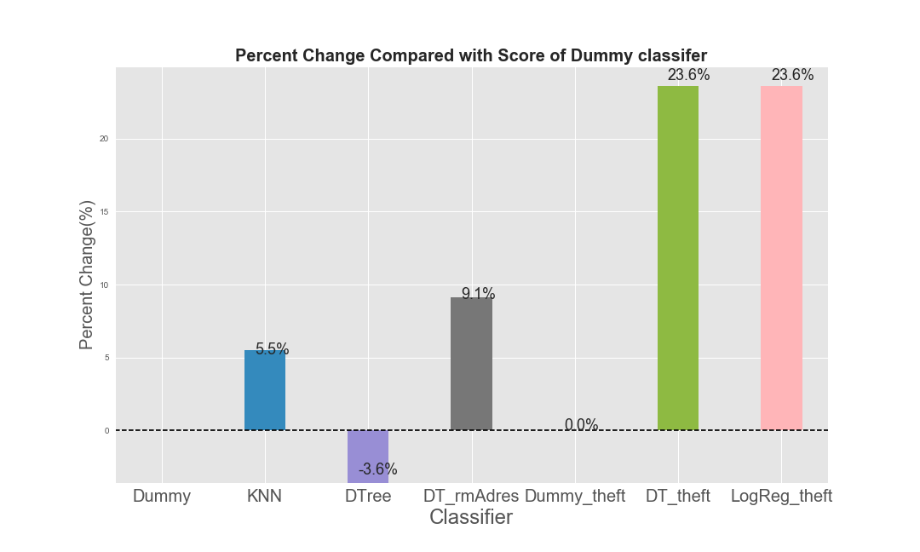
Machine Learning Models

Slide 25
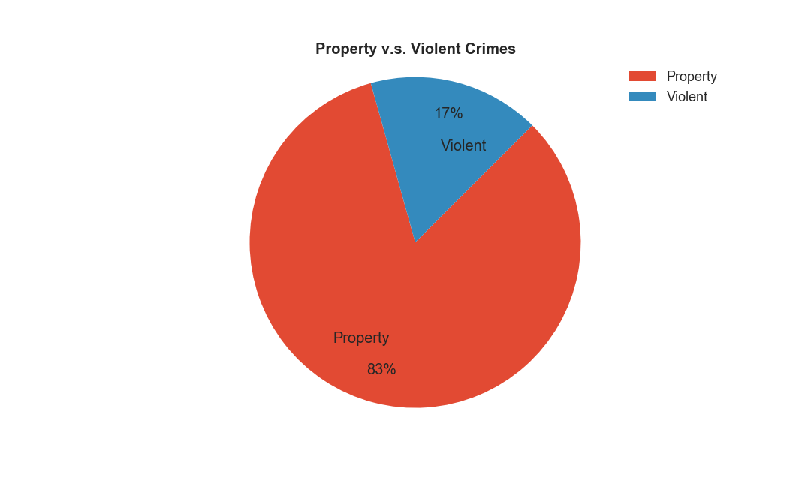
Violent/Property Crime
‘Theft’, ‘AutoTheft’, ‘Burglary’ are considered as property crimes, taking a proportion of 83% and ‘Robbery’, ‘AggravatedAssault’, ‘Murder’, ‘Rape’ are considered as violent crimes, taking a proportion of 17%.

Slide 26
Predictions
 | accuray | precision | recall | f1 | perct_change
Classifier
Dmy_PorV | 0.83 | 0.69 | 0.83 | 0.76 | 0.0
DT_PorV | 0.84 | 0.80 | 0.84 | 0.80 | 1.2
LogReg_PorV | 0.84 | 0.81 | 0.84 | 0.79 | 1.2
Dmy_rus | 0.50 | 0.25 | 0.50 | 0.33 | -39.8
DT_rus | 0.66 | 0.67 | 0.66 | 0.66 | -20.5
LogReg_rus | 0.68 | 0.68 | 0.68 | 0.68 | -18.1
Dmy_ros | 0.50 | 0.25 | 0.50 | 0.33 | -39.8
DT_ros | 0.68 | 0.68 | 0.68 | 0.68 | -18.1
LogReg_ros | 0.68 | 0.68 | 0.68 | 0.68 | -18.1
‘Dmy_PorV’ is the dummy classifier with predicting majority class strategy for property or violent crime; ‘DT_PorV’ is the decision tree classifier; ‘rus’ stands for random undersampling; ‘ros’ stands for random oversampling.

Slide 27

Conclusions
We loaded raw data from HPD and performed data cleaning and data wrangling.
We built machine learning models to predict types of crimes given predictor features constructed from insights gained from EDA and compare performances of classifiers .
We find it is quite hard to predict for the seven types of crimes. We are able to predict ‘Theft’ or ‘Not Theft’ with an accuracy of 68%, an increase by 24% compared to that of dummy classifier i.e., just predicting the majority class.
If we group crimes as ‘Property Crime’ (‘Theft’, ‘AutoTheft’, ‘Burglary’) and ‘Violent Crime’ (‘Assault’, ‘Murder’, ‘Rape’, ‘Robbery’), the best prediction is given by decision tree classifier and logistic regressor without random sampling with an accuracy of 84%.

Slide 28
Future Work
Improve accuracy:
Convert address into coordinates and involve that in prediction.
Get more data on crimes and enrich dataset with more features.
Other interesting questions include:
How is crime rate correlated with economic status and demographics?
How is crime rate related with weather?
Other potential datasets:
weather conditions economic status (unemployment rate) demographics (population change)

